Slide 1
Arquitetura Medalhão no Microsoft Fabric
Deep Dive
47

Slide 2
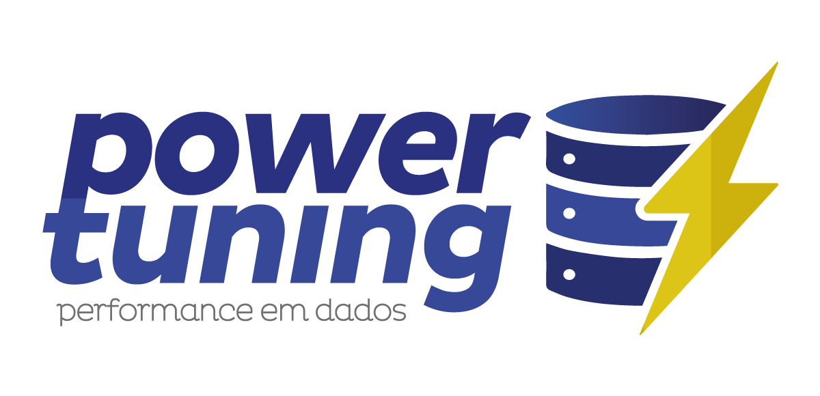

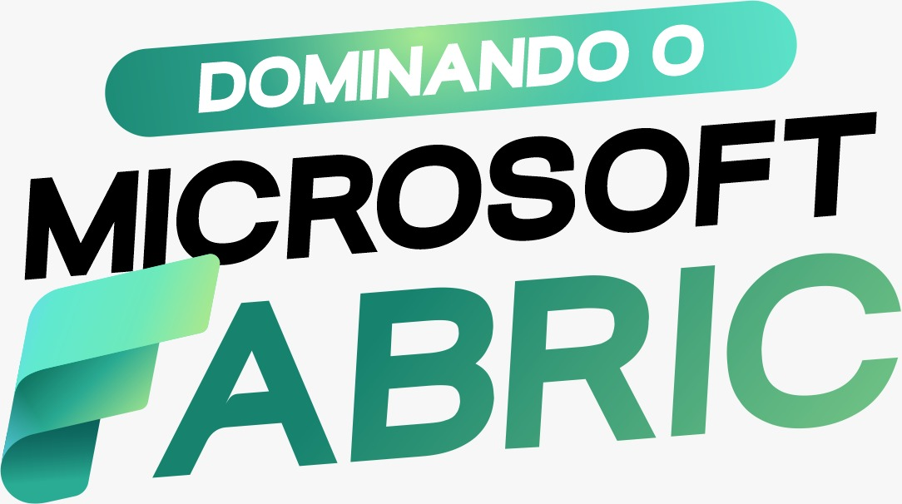

Apoio
Muito obrigado a estas empresas que estão nos apoiando nesse evento
Coffee Break e Brindes
Espaço e Infraestrutura
Inscrição e Credenciamento
Organização, Divulgação e Brindes
2009
2009
2009
2026
2026
https://www.powertuning.com.br
https://upis.br/
https://www.hubingressos.com.br/
2026
https://dominandomicrosoftfabric.com.br/
Consultoria de banco de dados
Monitoramento e Cursos
Plataforma de Power BI
IA Corporativa
Graduação
Pós-Graduação
55 anos de tradição em Brasília
60 mil profissionais formados
Plataforma de Eventos
Credenciamento com QR Code
Check-in rápido
Captura de leads e Relatórios
Treinamento em Microsoft Fabric
Maior coleção de cursos em português
Workshops, clube do livro e mentorias
Comunidade para profissionais de dados

Slide 3



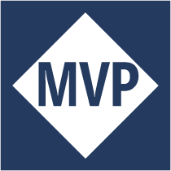

O Brasília Data Group
Objetivo
Encontros presenciais gratuitos e com qualidade
Código de Conduta
Respeito máximo a todos!
https://brasiliadata.group/codigo-de-conduta
2009
2026
Rodrigo
2009
Sidney
Líder
Co-Líder

Slide 4



Voluntários
Wellington Marques
Igor Ferrer
Márcio Lima
2009
2009
2009
2009
2009
2009
2009
2009
2009
Engenheiro de Dados, TechCom
Senior Data Engineer , Hitss Brasil
DBA, Amazon Informática
https://www.linkedin.com/in/tonfly
https://www.linkedin.com/in/igorferrer-data
https://www.linkedin.com/in/marciolimaa
https://github.com/tonfly
https://github.com/igorferrer-data

Slide 5

Orientações para este encontro
19h00
19h05
20h35
21h05
Recepção
(10min)
Intro
(5min)
Palestra
1h a 1h30
sorteios
15min
Interações
20min

Slide 6
Próximos encontros
Próximos Encontros
  #48 - O que é observabilidade previsto
  Augusto Ferronato, AWS
  #49 - Hackeando o SQL Server em todas as Clouds
  Fabiano Amorim, Pythian
100
previsto
21/05**
400
previsto
04/06**

Slide 7




Canais Oficiais
https://brasiliadata.group
Site oficial | Fonte da verdade (documentação)
Atualizações | Lista dos Encontros
https://brasiliadata.group/canais-e-redes-sociais
Atualizações, discussões, ajuda, brindes
2009
2026
Atualizações, dicas, conteudo técnico
Fotos e vídeos dos encontros, atualizações
@bsbdata

Slide 8
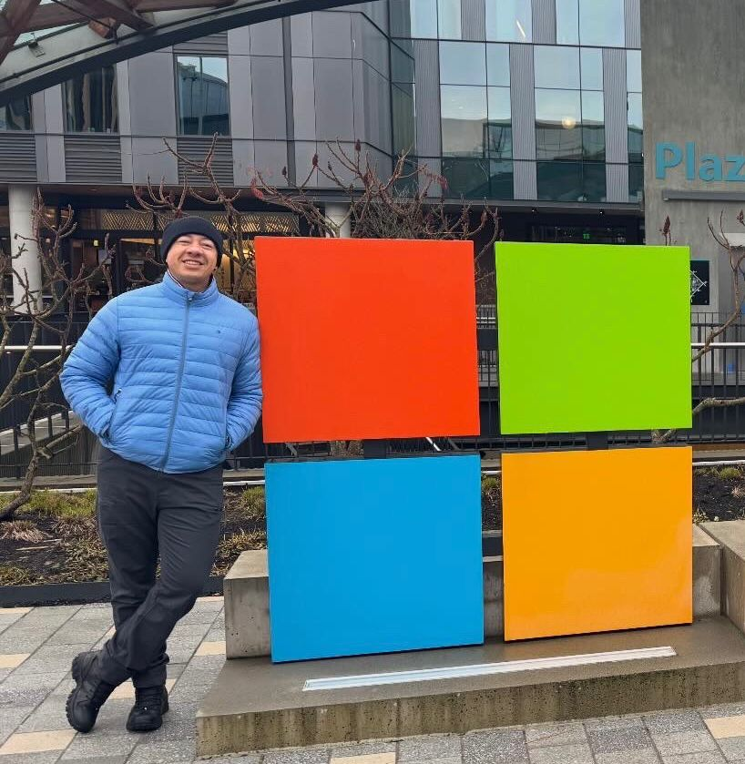



Sidney Cirqueira
☁️ Sr. Cloud & AI Solution Architect na Microsoft
📊 +13 anos trabalhando com Dados e Analytics
2,5 no time de Suporte Global do Microsoft Fabric
🥷 Fabric Data Insider
👨‍🏫 Palestrante na comunidade técnica Microsoft
@sidney_cirqueira
sidneyoliveiracirqueira

Slide 9


Slide 10




Unified data analytics platform for accelerating innovation across
data science, data engineering, and business analytics
Global company with 5,000 customers and 450+ partners
Original creators of popular data and machine learning open source projects

Slide 11
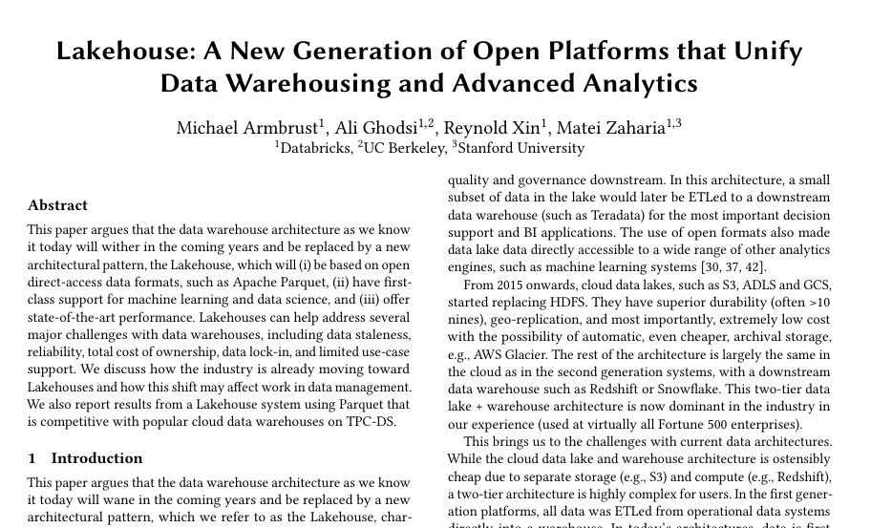
Lakehouse: From Concept to Modern Data Standard (2020–2021)
https://www.cidrdb.org/cidr2021/papers/cidr2021_paper17.pdf

Slide 12

Simple explanation of Lakehouse
+
Data Lake
Data warehouse
Scalable, distributed file storage​
Flexible schema-on-read semantics​
Big data technology compatibility​
Relational schema modeling​
SQL-based querying​
Proven basis for reporting and analytics​

Slide 13
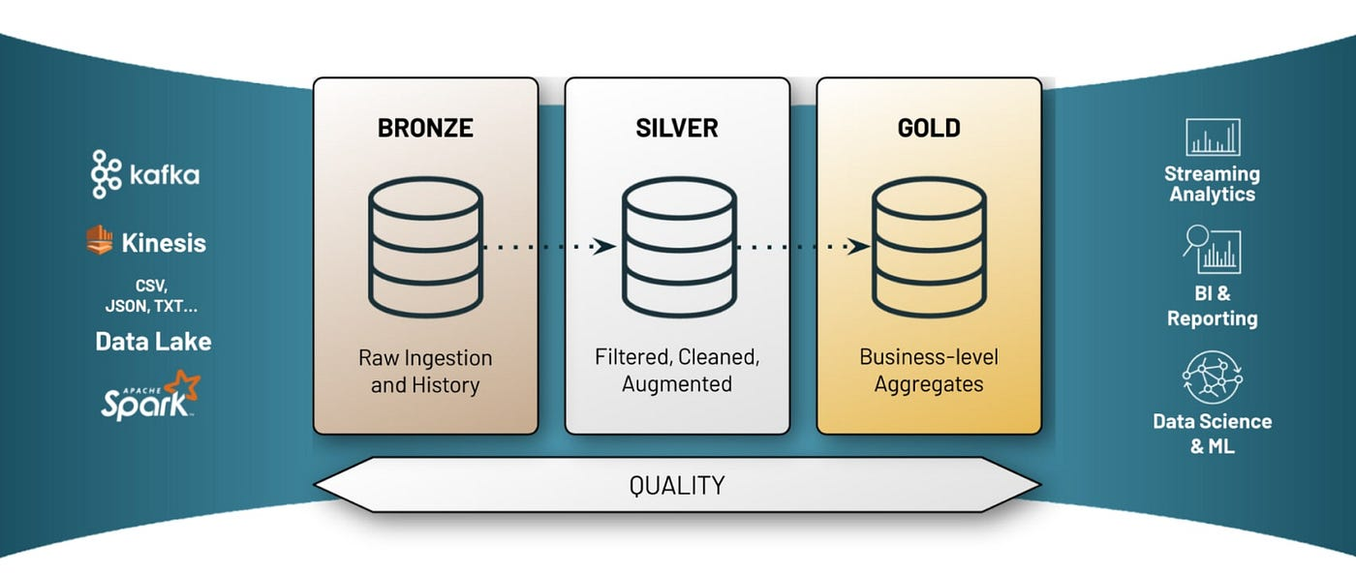
Medallion Architecture
Notes:
The medallion design pattern, coined by Databricks, is used to logically organize data in the three-layered structure seen in data warehouses.
The lakehouse combines characteristics of data lakes and data warehouses. The lake decouples storage from compute. It enables the storage of massive amounts of both structured and unstructured data, while the warehouse pattern introduces some level of ACID compliance (versioning Delta files).
Lakehouses combine some of the benefits of both data warehouses and data lakehouses, but they may not be practical for teams that require high read performance or strong data integrity.

Slide 14
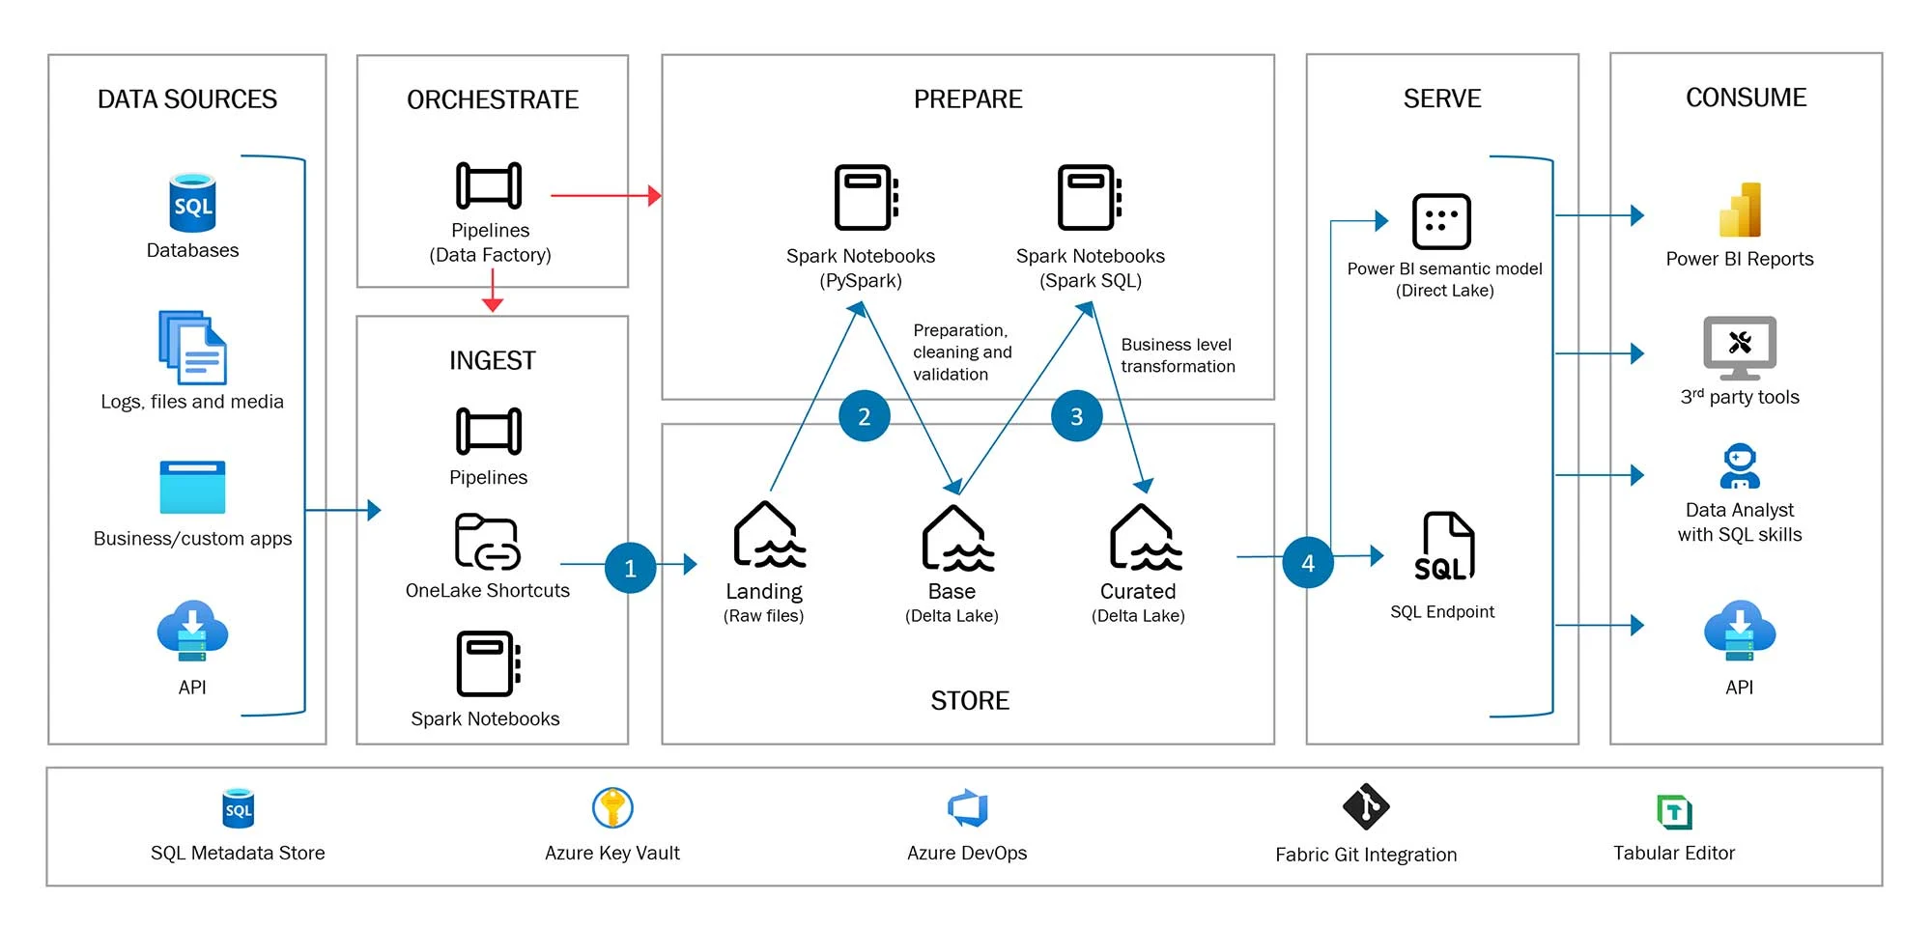
Lakehouse Architecture

Slide 15
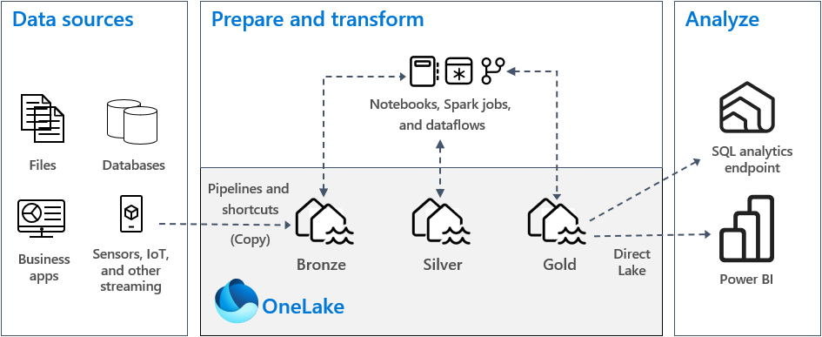
Medallion Architecture
Notes:
The medallion design pattern, coined by Databricks, is used to logically organize data in the three-layered structure seen in data warehouses.
The lakehouse combines characteristics of data lakes and data warehouses. The lake decouples storage from compute. It enables the storage of massive amounts of both structured and unstructured data, while the warehouse pattern introduces some level of ACID compliance (versioning Delta files).
Lakehouses combine some of the benefits of both data warehouses and data lakehouses, but they may not be practical for teams that require high read performance or strong data integrity.

Slide 16
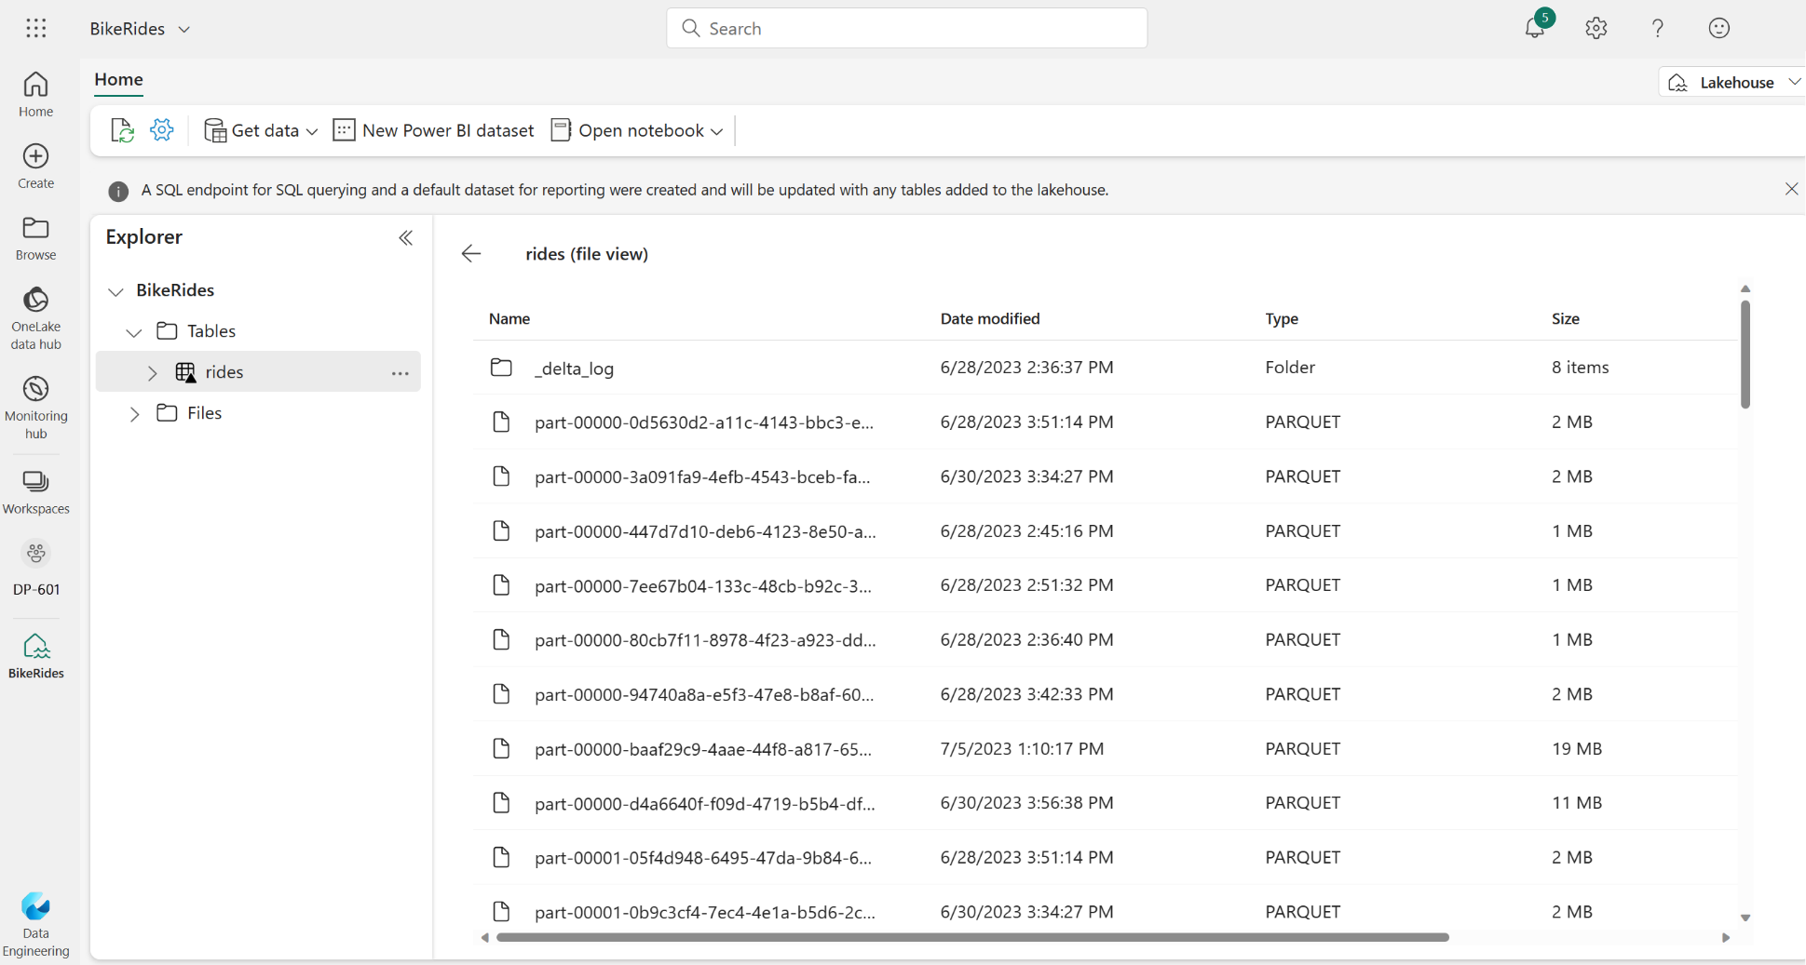
Understand Delta Lake
Relational tables that support querying and data modification
Support for ACID transactions
Data versioning and time travel
Standard formats and interoperability
Notes:
Delta Lake is an open-source storage layer that adds relational database semantics to Spark-based data lake processing. Tables in Microsoft Fabric lakehouses are Delta tables, which is signified by the triangular Delta (▴) icon on tables in the lakehouse user interface.
Delta tables are schema abstractions over data files that are stored in Delta format. For each table, the lakehouse stores a folder containing Parquet data files and a _delta_Log folder in which transaction details are logged in JSON format.
Relational tables that support querying and data modification. With Apache Spark, you can store data in Delta tables that support CRUD (create, read, update, and delete) operations. In other words, you can select, insert, update, and delete rows of data in the same way you would in a relational database system.
Support for ACID transactions. Relational databases are designed to support transactional data modifications that provide atomicity (transactions complete as a single unit of work), consistency (transactions leave the database in a consistent state), isolation (in-process transactions can't interfere with one another), and durability (when a transaction completes, the changes it made are persisted). Delta Lake brings this same transactional support to Spark by implementing a transaction log and enforcing serializable isolation for concurrent operations.
Data versioning and time travel. Because all transactions are logged in the transaction log, you can track multiple versions of each table row and even use the time travel feature to retrieve a previous version of a row in a query.
Support for batch and streaming data. While most relational databases include tables that store static data, Spark includes native support for streaming data through the Spark Structured Streaming API. Delta Lake tables can be used as both sinks (destinations) and sources for streaming data.
Standard formats and interoperability. The underlying data for Delta tables is stored in Parquet format, which is commonly used in data lake ingestion pipelines. Additionally, you can use the SQL Endpoint for the Microsoft Fabric lakehouse to query Delta tables in SQL.

Slide 17
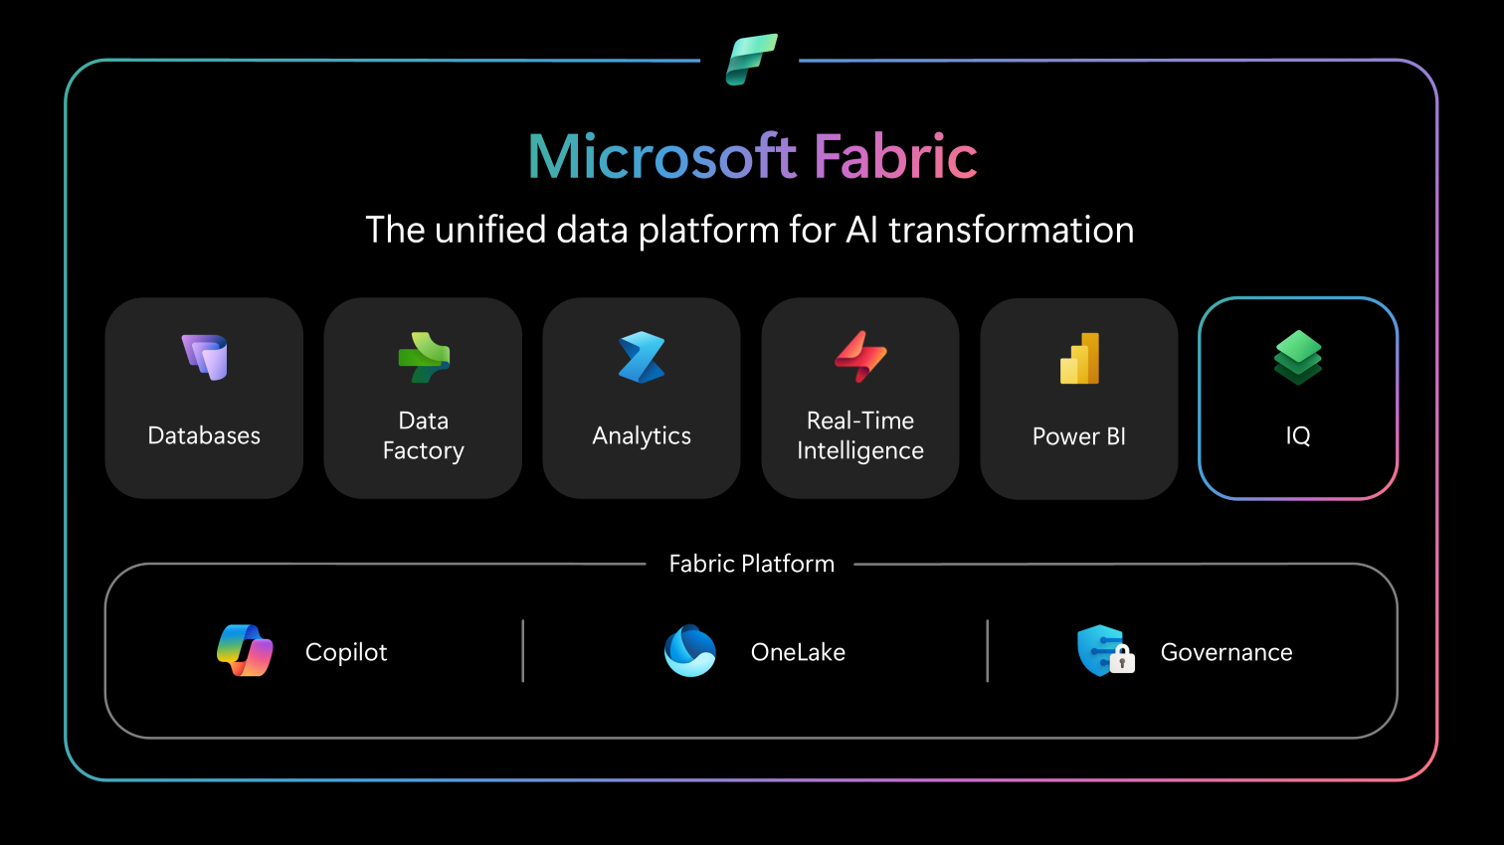

Slide 18
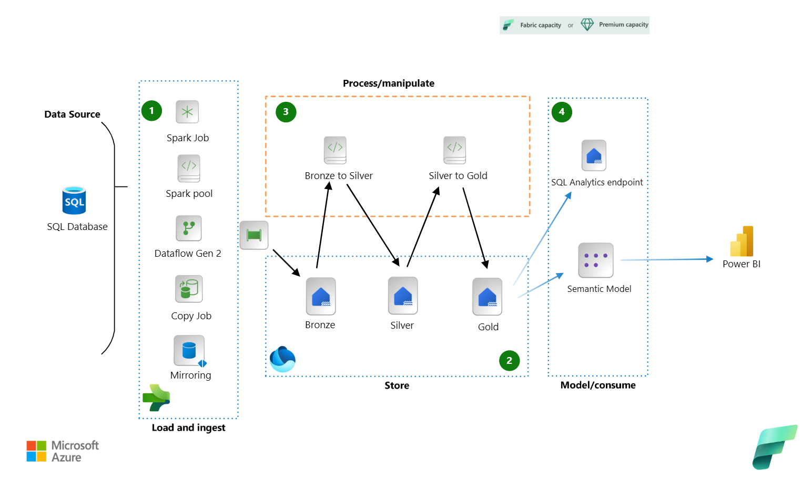
lakehouse architecture.vsdx
Notes:
lakehouse architecture.vsdx

Slide 19
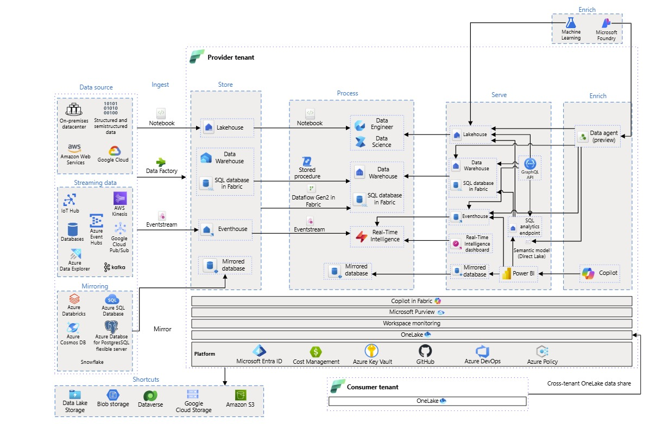
lakehouse architecture.vsdx
Notes:
lakehouse architecture.vsdx

Slide 20
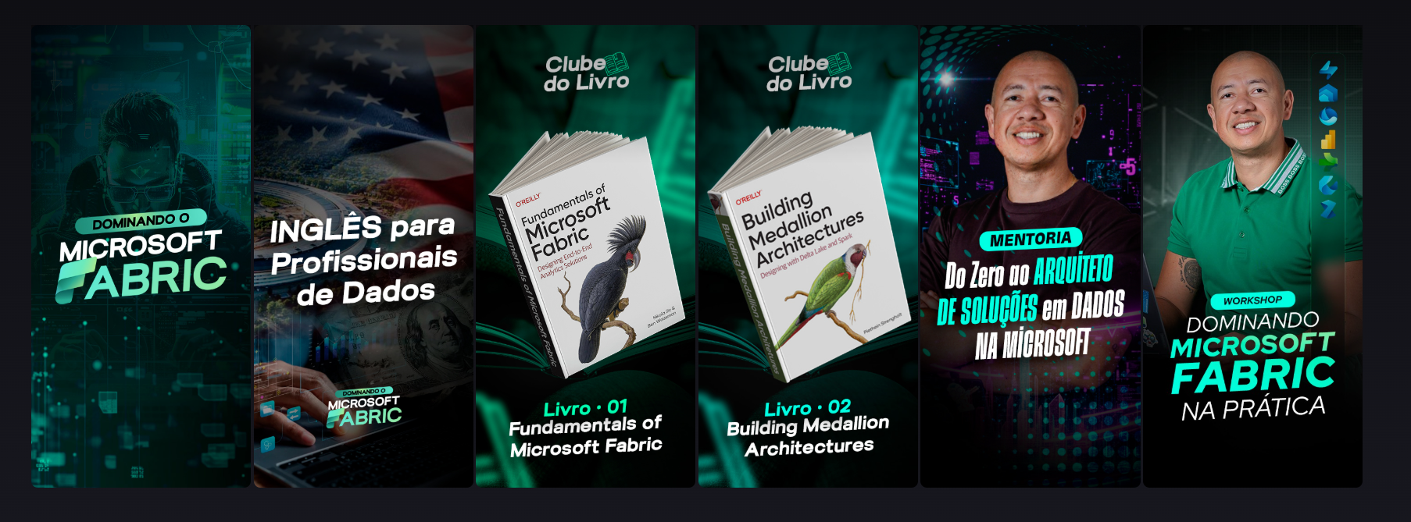
Cupom 70 % OFF
Notes:
lakehouse architecture.vsdx

Slide 21
Thank You!!!
Notes:
lakehouse architecture.vsdx

